Slide 1
Tools for
the assessment of
phenomenon-based learning

Slide 2
Guidelines for using the tools
Do not edit the original files; instead download the tools for editing to your own computer.
The “Modeling of phenomenon-based learning project” at the development services of the Education Division of the City of Helsinki has developed a collection of tools for phenomenon-based learning which can be used to better monitor and assess learning by comprehensive school pupils. The tools include ones aimed at both teachers and learners, and they operate in both the digital (O365 and Google) and physical environments. The tools are freely available for use by everyone, and they can be edited to suit one’s own application.
Notes:
for the suitability of tools for the O365 and Google environments?

Slide 3


Assessment tools for the various phases of phenomenon-based learning
The duration of the process over several weeks
GOALS
PARTICIPATION
ASSESSMENT
Teachers
Survey the subject-specific goals from the curriculum
Select the phenomenon and specify the main goals for the phenomenon
Begin to teach the phenomenon together
Meet the learners at least once during the phenomenon and direct the phenomenon in their respective subjects.
Decide on the phenomenon jointly
Interim assessment of the phenomenon process (pp. 23–25)
Assessment of the process (pp. 23–25)
Subject-specific goals (pp. 4–7)
Goals for transversal competence (pp. 10–19)
Goals of the phenomenon process (pp. 22–25)
Final assessment (p. 8)
GOALS
PARTICIPATION
ASSESSMENT
Learner
Assessment of transversal competence (pp. 16 and 20)
Goals of the phenomenon process (pp. 23–25)
1. Description of the phenomenon
2. Are inspired by the phenomenon
3. Set personal goals
4. Draw up the plan
Share what they have learned with others
Interim assessment and final assessment (p. 8)
Assessment tool for the phenomenon process (pp. 23–25)
Peer review and Help wall
(pp. 28–29)
Assessment of transversal competence (p. 20)
ASSESSMENT TOOLS FOR PHENOMENON-BASED LEARNING

Slide 4
Assessment of transversal competence

Slide 5
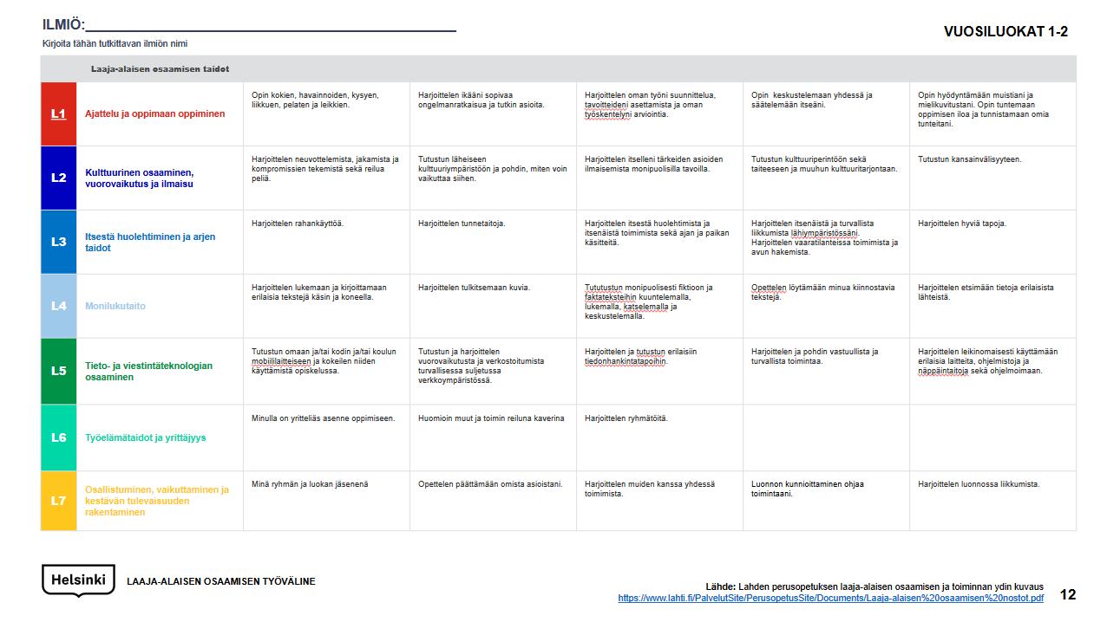
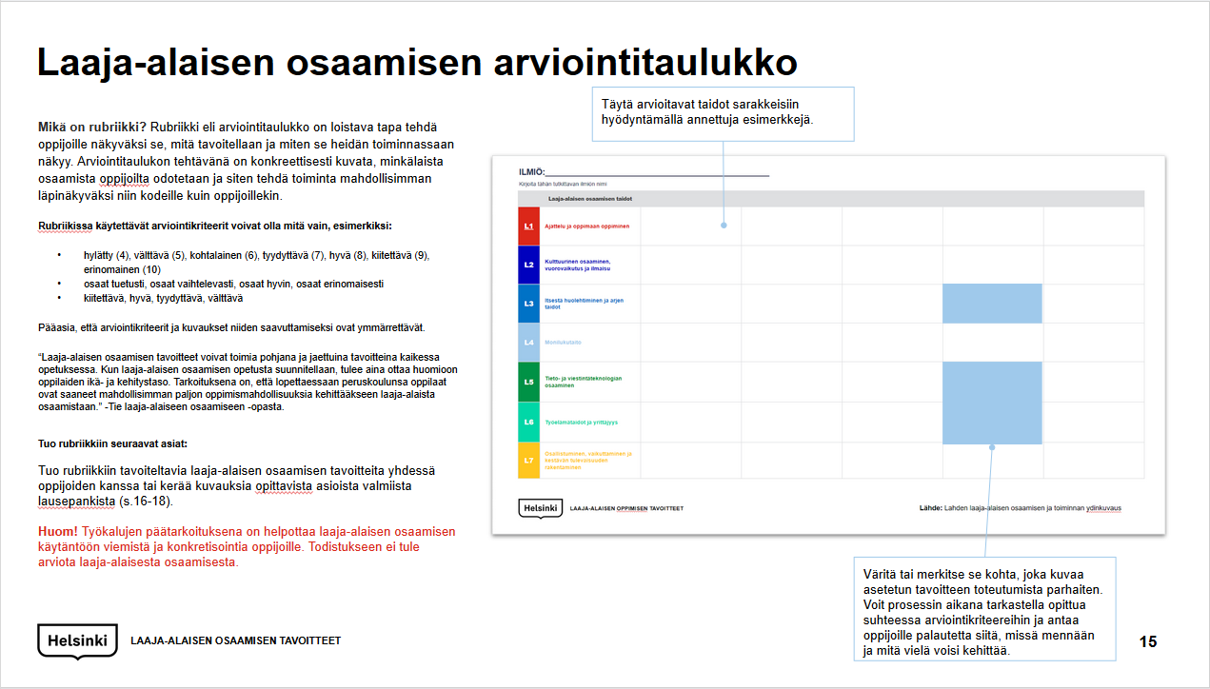
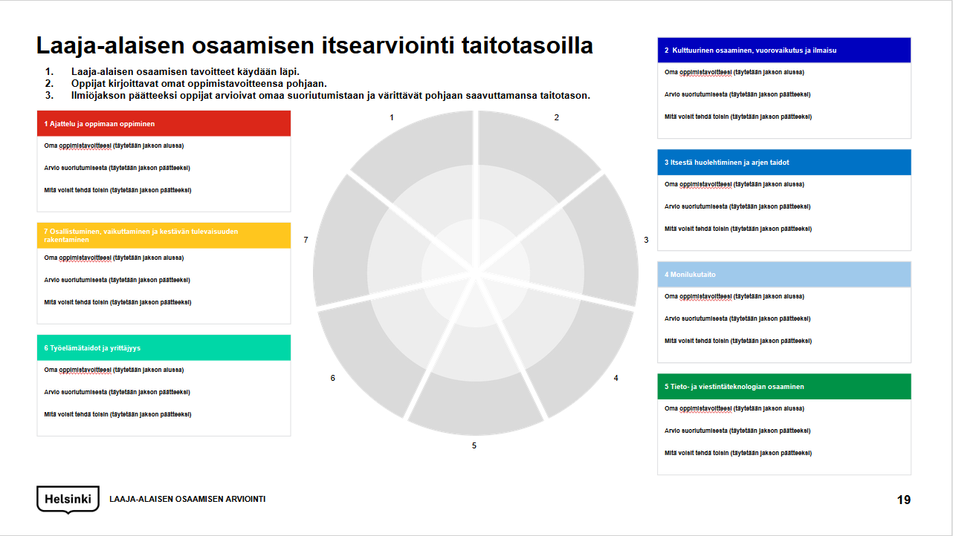
Tools
To help learners commit to achieving the goals for transversal competence, teaching should make the goals as concrete and understandable as possible. Learners should grow with the assessment of skills and consider the stage they are at in learning them. Here, you can find three different tools to support the assessment of goals for transversal competence. Please note that no grade is given for the realization of goals for transversal competence.
Core description of transversal competence and activity in Lahti (pp. 12–14)
Lahti has developed a tool for transversal competence in basic education which describes the goals for transversal competence by class grade.
Assessment table and phrase bank for transversal competence (pp. 15–19)
Goals for transversal competence can also be picked for the rubric on a phrase-specific basis. Enclosed are helpful descriptions for each section that use subheadings from material prepared by Lonka et al. (http://ele.fi/assets/arviointikehikko_microsoft_170605.pdf). You can use the helpful descriptions and select from them applicable parts, edit the phrases to be more suitable for your group of learners, and add them to the assessment table. Putting the goals for transversal competence in words with learners helps them understand what the goals mean, and why they should be learned.
Self-assessment of transversal competence at skill levels (p. 20)
Assessment of the realization of transversal competence can also be done with a figure, with competence packages divided into four different skill levels. Learners can assess their competence step by step from the first skill level (skill level 0) to the last (skill level 3). At the initial level, the skill is recognized as important and set as the goal for learning. At the next level, learning of skills can be implemented methodically but in a more teacher-led manner. At the last level, learners have learned to act more independently and with greater self-direction. You can bring the objects assessed from the Lahti model or from descriptions of transversal competence, or you can prepare the objects assessed with the learners.
ASSESSMENT TOOLS FOR TRANSVERSAL COMPETENCE

Slide 6

Goals for transversal
competence
T1
Thinking and Learning to Learn
T2
Cultural Competence, Interaction and Self-Expression
Source: http://ele.fi/assets/arviointikehikko_microsoft_170605.pdf
T7
Participating, Influencing and Building a Sustainable Future
T3
Self-Care
and Managing Everyday Life
.
Initial
level
T6
Working Life Skills and Entrepreneurship
T4
Multiliteracy
T5
Information and Communication Technology (ICT) Competence
GOALS FOR TRANSVERSAL COMPETENCE

Slide 7
PHENOMENON:________________________________________________
Write the name of the phenomenon studied here
GRADES 1–2
 | Skills in transversal competence
T1 | Thinking and learning to learn | I learn by experiencing, observing, asking, moving, and playing sports and games. | I practice age-appropriate solving of problems and explore things. | I practice planning of my own work, setting of my goals, and assessing my own work. | I learn how to discuss with other people and to regulate myself. | I learn how to use my memory and imagination. I learn how to feel the joy of learning and to identify my own emotions.
T2 | Cultural Competence, Interaction and Self-Expression | I practice negotiation, sharing and making compromises, and fair play. | I familiarize myself with the local cultural environment and think about how I can influence it. | I practice expressing things important for me in a variety of ways. | I familiarize myself with cultural heritage, art and other cultural offerings. | I familiarize myself with internationalism.
T3 | Self-care and managing everyday life | I practice how to use money. | I practice emotional skills. | I practice looking after myself and independent activity, and concepts of time and place. | I practice independent and safe movement in my immediate surroundings. I practice acting in dangerous situations and seeking help. | I practice good manners.
T4 | Multiliteracy | I practice reading and writing different texts by hand and computer. | I practice interpreting images. | I familiarize myself with fiction and factual texts in a variety of ways by listening, reading, viewing and discussing. | I learn how to find texts that are interesting to me. | I practice finding information from different sources.
T5 | Information and communication technology (ICT) competence | I familiarize myself with my own and/or the home’s and/or school’s mobile devices and experiment with using them in my studies. | I familiarize myself with and practice social interaction and networking in a safe closed network environment. | I practice and familiarize myself with different ways to acquire information. | I practice and think about responsible and safe activities. | I playfully practice using different devices, software, keyboard skills and programming.
T6 | Working life skills and entrepreneurship | I have an enterprising attitude toward learning. | I take others into account and act as a good friend. | I practice group assignments.
T7 | Participating, influencing and building a sustainable future | Myself as a member of the group and class. | I learn how to make decisions concerning my own affairs. | I practice working with other people. | My actions are guided by respect for nature. | I practice moving around in nature.
TOOL FOR TRANSVERSAL COMPETENCE
Source: Core description of transversal competence and activity in basic education in Lahti
https://www.lahti.fi/PalvelutSite/PerusopetusSite/Documents/Laaja-alaisen%20osaamisen%20nostot.pdf

Slide 8
PHENOMENON:________________________________________________
Write the name of the phenomenon studied here
GRADES 3-6
 | Skills in transversal competence
T1 | Thinking and learning to learn | I learn how to ask questions, and find answers for them alone and with other people, and my problem-solving ability becomes stronger. | I practice seeing relationships and interaction between different matters. | I learn how to understand the construction of knowledge in different ways. | I learn the skills of working together and peer learning. I learn how to tolerate disappointment. | I learns skills and learning styles needed in learning, and I practice enhancing them in all subjects under guidance.*)
T2 | Cultural Competence, Interaction and Self-Expression | I know and respect my own and other people’s social, cultural, religious, ethical and linguistic roots. | I familiarize myself with the culture of the school community and my home region, its changes and diversity. | I learn how to identify and think about the effect of the media. | I experiment with different methods of expression, and practice putting myself in another person’s position and reviewing matters from different perspectives. | I familiarize myself with international cooperation and am encouraged to express myself in a foreign language.
T3 | Self-care and managing everyday life | I learn how to act as a consumer. | I learn how to protect my privacy. I understand my own and other people’s limits. | I learn emotional and social skills. | I practice traffic safety and how to act in dangerous situations. | I practice taking responsibility for my learning environment. I contribute to the preparation of joint rules.
T4 | Multiliteracy | I deepen my textual skills by reading/listening, producing and analyzing different texts. | I know how to work with a range of study texts: I recount, describe, compare and explain. | I know how to search for information from different sources and practice having a critical attitude toward texts. | I practice discussing texts and working on them with others. | I enjoy texts that are interesting to me.
T5 | Information and communication technology (ICT) competence | I know how to utilize my own or the school’s mobile device in learning. | I know how to interact, network and edit information in collaboration with other people. | I know how to search for information, produce information by myself and critically evaluate information found on the Web. | I know how to act responsibly and safely. | I learn how to use different devices, software and services. I develop my keyboard skills and learn how to produce media content. I understand the operational logic of programming.
T6 | Working life skills and entrepreneurship | I am responsible for myself and my own competence. | I have an understanding of team skills and teamwork. | I take part in the making of projects.
T7 | Participating, influencing and building a sustainable future | As a member of my own school | I grow up as a member of the community. I take part in joint decision making. | I learn how to make choices in accordance with sustainable development. | I develop a personal relationship with nature. | I learn how to protect the environment.
TOOL FOR TRANSVERSAL COMPETENCE
Source: Core description of transversal competence and activity in basic education in Lahti
https://www.lahti.fi/PalvelutSite/PerusopetusSite/Documents/Laaja-alaisen%20osaamisen%20nostot.pdf

Slide 9
PHENOMENON:________________________________________________
Write the name of the phenomenon studied here
GRADES 7-9
 | Skills in transversal competence
T1 | Thinking and learning to learn | I use various methods to enhance my own attentiveness and concentration. I identify my own emotions and learn how to cope with them. | I trust my own views and utilize and respect the competence I have acquired myself outside the school. | I argue, conclude and deliberate. I present my own ideas and thoughts. I study the construction of knowledge by myself and with other people. | I work across subject-based boundaries and study phenomena in different ways, utilizing technology. I develop my sensitivity of observation and cooperation skills. | I enhance my thinking skills, motivation to learn, ethical thinking and the significance of my studies for my future. I believe in my ability to learn.
T2 | Cultural competence, interaction and self-expression | I formulate my own cultural identity and a culturally sustainable way of life. | I understand that cultural diversity is an asset. | I express my opinions constructively, in various ways, and create a positive atmosphere. | I respect, maintain and create new cultural heritage. | My view of the world expands towards internationalism.
T3 | Self-care and managing everyday life | I receive guidance for planning and taking care of my own finances. I review my own consumption habits from the perspective of a sustainable future and advertising communication in an analytical manner. | I take responsibility for myself, other people and a smooth everyday life. I can contribute to the planning and implementation of school work and the learning environment. | I am aware of the importance of a healthy way of life. I practice social and emotional skills. I practice protecting my privacy and personal boundaries. | I learn how to anticipate and avoid dangerous situations, and how to act appropriately in the event of an accident. I act responsibly in traffic.
T4 | Multiliteracy | I know how to read/listen, produce and analyze different texts related to studies and society, and have a critical attitude toward the content of texts. | I receive joy and entertainment from texts in my life and can choose texts that are interesting to me. | I understand how texts can be used to influence people, and I also know how to use methods of influence myself. | I know how to discuss texts, work on them with others and use texts efficiently in my studies.
T5 | Information and communication technology (ICT) competence | I know how to use my own or the school’s mobile device in learning proactively and in various ways. | I know how to interact and network in open network environments and have a responsible attitude toward acting in them. | I know how to have a critical attitude towards information on the Web, draw conclusions and search for information from different channels in various ways. | I know how to proactively work responsibly and safely, and regulate the visibility of information concerning me online. | I know how to proactively select a device, program and service. I produce media content in various ways. I familiarize myself with the correct programming language.
T6 | Working life skills and entrepreneurship | I am willing and able to better myself. | I have the skill to act as a responsible member in a group. | I undertake learner-oriented projects.
T7 | Participating, influencing and building a sustainable future | As a member of society | I understand the possibilities of influencing. | I can be an active citizen whenever necessary. | I act in line with a sustainable way of life. | I learn how to take responsibility for the environment.
TOOL FOR TRANSVERSAL COMPETENCE
Source: Core description of transversal competence and activity in basic education in Lahti
https://www.lahti.fi/PalvelutSite/PerusopetusSite/Documents/Laaja-alaisen%20osaamisen%20nostot.pdf

Slide 10
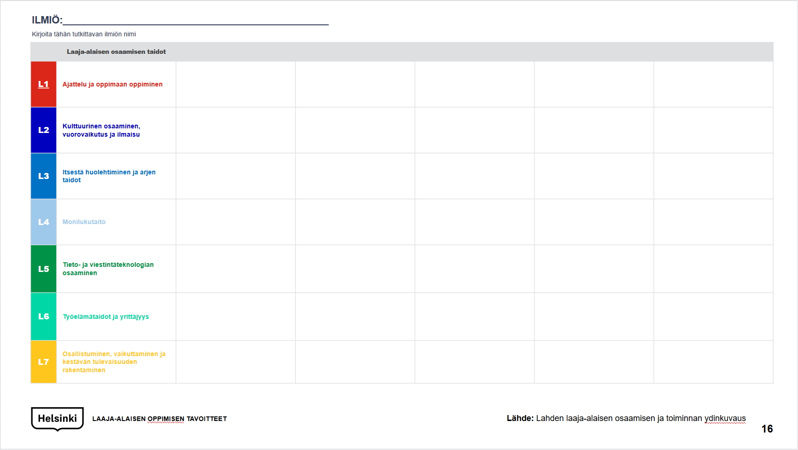
Assessment table for transversal competence
Fill out the skills being assessed in the columns by using the examples provided.
What is a rubric? A rubric, or an assessment table, is an excellent way to make learners see what is being looked for, and how this is displayed in their activity. The task of the assessment table is to concretely describe the kind of competence that is expected from learners, and to make the activity as transparent as possible for both homes and learners.
The assessment criteria used in the rubric can be anything at all, such as:
you can do this with support, you can do this to a varying extent, you can do this well, you can do this excellently
excellent, good, satisfactory, adequate
The main thing is that the assessment criteria and the descriptions for attaining these are understandable.
“The intrinsic objectives of 21st Century competence can act as a basis for all of the teachers’ mutual, and personal, teaching goals. When teaching of transversal competence is planned, the students’ age and development levels must always be taken into account. The aim is to ensure that when students graduate from school, they will have had as many opportunities as possible to develop their 21st Century skillsets.” - From the “Road to 21st Century Competence” guidebook.
Import the following matters to the rubric:
Import desirable goals for transversal competence to the rubric with learners or collect descriptions of matters to be learned from the phrase bank (pp. 16–18).
Note! The main purpose of the tools is to make it easier to bring transversal competence into practice and make it concrete for learners. The certificate will not include an assessment of transversal competence.
Shade or mark the section that best describes the realization of the goal set. During the process, you can review lessons learned in relation to the assessment criteria and give learners feedback on where you are going and what could be developed further.
GOALS FOR TRANSVERSAL COMPETENCE

Slide 11
PHENOMENON:________________________________________________
Write the name of the phenomenon studied here
 | Skills in transversal competence
T1 | Thinking and learning to learn
T2 | Cultural competence, interaction and self-expression
T3 | Self-care and managing everyday life
T4 | Multiliteracy
T5 | Information and communication technology (ICT) competence
T6 | Working life skills and entrepreneurship
T7 | Participating, influencing and building a sustainable future
TOOL FOR TRANSVERSAL COMPETENCE

Slide 12



T1 Thinking and learning to learn
Enquiry-based learning
You know how to set goals for your own work and assess your activity in relation to them.
You know how to search for and construct information, describe matters in your own words, and share your thoughts and ideas with other people.
You know how to plan your work and assess its success in relation to the goals set.
You know how to act alone and with others.
You understand how information is constructed, and where different kinds of information can be found.
You have learned how important it is to evaluate the credibility of information and consider how to act when the information is contradictory.
You persistently look for the right decisions and understand how some matters take time to evolve.
You know how to throw yourself into a process and boldly experiment with new alternatives.
You dare to give time to learning and creative thinking.
You do not hesitate to ask, wonder and contemplate. You know how to listen to others and take different perspectives into account.
Me as a learner
You know how to take responsibility for your own learning.
You set goals for your work, think about how to achieve them, assess your own activity in relation to the goals set and change your actions when necessary.
You actively hold the reins of your own learning.
You believe in your own skills, you do not hesitate to face challenges, and even if you confront adversity, you ask for help if necessary to solve problems.
You know how to assess which aspects you are strong at, and which aspects require further work.
You can identify how you typically act and know how to develop your own skills to make them more versatile.
You are enthusiastic about learning new things and challenging yourself to learn new procedures.
You know how to describe what you have learned and understand how your learning process is constructed.
You know how to justify choices you make and describe the goals of the learning process.
You boldly experiment with new things and challenge yourself as a learner.
You take responsibility for your own work and learning.
T1 Thinking and learning to learn
Learning community
You know how to take account of other people, listen to their thoughts and treat them with respect.
You know how to act in different configurations and produce ideas, and investigate and resolve matters with other people.
You take different people into account and give everyone room to be themselves.
You know how to share your thoughts and ideas with other people and understand that cooperation is strength.
You know how to support other members of the group and offer help when necessary.
T2 Cultural competence, interaction and self-expression
Cultural encounters
You are interested in learning about other cultures.
You understand where your own roots lie, and what your own story, worldview and culture are like.
You understand how cultures are born and see different cultures as an asset.
You think about how cultures are born, and how they influence our choices.
You are interested in traditions, art and various forms of culture.
You have practiced self-expression with different forms of culture and considered your own role as a builder of culture.
You boldly explore different cultures and want to learn new things and ways of action.
Emotional skills
You know how to identify and name different emotions, and describe your own feelings and thoughts.
You have learned to regulate your emotions and know how they affect you.
You believe in yourself and know that you can find answers to even difficult questions.
You want to learn new skills and develop yourself.
You are able to work persistently and for a long time, even if the matters being learned sometimes seem difficult and frustrating.
Cultural participation
You know how to share what you have learned with others and express yourself in different ways.
You boldly learn new ways to appear in public and present your thoughts to other people.
You are interested in different ways of expression and want to learn new things.
You understand that people can communicate in many different ways: through their clothes, music, art, literature and physical exercise.
You are interested in taking a stand on matters and understand how culture can be used to influence people.
You have learned how your own cultural background has affected you and for your part, you can influence other people in the future.
T3 Self-care and managing everyday life
Managing everyday life
You have learned to look after yourself.
You know how to regulate your everyday functions: you understand how long it takes you to do daily chores and know how to manage your time.
You have learned to anticipate things and plan your actions, and you know how to adapt to changed circumstances.
You understand what consumption habits are and know how to assess your own actions as a consumer.
You understand how to learn to manage your own finances and the kind of skills this requires.
You know how to take care of your belongings and act frugally.
You know how to share things with others and understand the significance of a sustainable way of life.
You have learned to view the world according to sustainable principles and understand how you can improve the future through your own actions.
You have learned to review different kinds of media and understand how advertising methods affect people.
You know how to have a critical attitude toward media, and understand how different channels and monitoring systems can influence a person’s thoughts.
You know how to use technology in different ways to search for, construct, edit and share information.
You are inspired to learn new things and skills in the field of technology.
You understand how technology affects our daily lives in many ways.
Being a member of a well-functioning society
You have learned to cooperate with other people.
You know how to take other people into account and understand how your actions affect others.
You have learned a great deal about wellbeing and understand what factors affect a person’s health.
You know how to make conscious choices to promote your own wellbeing.
You have learned to monitor your own actions and listen to your own body.
You understand that information related to wellbeing can be contradictory, and that critical evaluation is the essential aspect for the reliability of a subject matter.
You have learned that a human being is an intricate and multidimensional psychological, physical and social entity.
Source: Heidi Halkilahti
PHRASE BANK FOR TRANSVERSAL COMPETENCE

Slide 13


T3 Self-care and managing everyday life
Safety and security in everyday life
You have learned what kinds of matter are associated with safety and how to act safely.
You know how to identify different symbols related to safety, and you observe them.
You know how to act responsibly in dangerous situations and look after your own and other people’s safety.
You know how to discuss and distinguish which factors build a sense of security for you (and for other people).
You can describe what privacy means, and what personal boundaries are.
You know how to protect your own privacy and think of how to protect your personal affairs.
You can contemplate how factors that threaten privacy can be avoided.
T4 Multiliteracy
Communication
You know how to perceive different messages, and you recognize texts as well as spoken, visual and symbolic language.
You have learned how important it is when producing content to think about who it is aimed at.
You know how to use messages in a range of ways for different purposes.
You have learned to express yourself in various ways, and you are ready to boldly experiment with different forms of expression in different media.
Multimedia and communication
You know how to produce different kinds of information and edit content for different communication purposes.
You know how to produce various matters in cooperation with other people. You understand well what kinds of information can be published, and what kind of content is appropriate for public media outlets.
You can use different forms of communication in a range of ways, identify styles of messages and utilize them for various purposes.
Contextual skills
You have learned how messages express their cultural background, and that they must always be interpreted as representatives of their cultural context.
You understand how our background affects our interpretation, so the same message can have many different meanings for various users.
You have learned that different cultures may communicate in very different ways, both verbally and visually.
You know how to justify your own views and choices.
You have learned that various fields of science and art communicate in different ways and apply the language accordingly.
You know how to write appropriately for different situations.
T5 Information and communication technology (ICT) competence
Enquiry-based and creative studying: data management
You have learned a great deal about an enquiry-based way of working.
You know how to search for information, construct it in cooperation with others, consider the reliability of information, and use the media in various ways.
You know how to use sources and understand how to verify their reliability.
You know how to use different search engines and technological applications to acquire and construct information, and share what you have learned in different ways.
You have learned to consider which application best serves what you have learned and to share your lessons with other people.
You want to learn new skills for expressing yourself and boldly experiment with things that seem alien to you at first.
You know how to model what you have learned in different ways.
You know how to save information, merge what you have learned with earlier information, edit information in different ways and apply it in different situations.
You know how to assemble your knowledge, skills and lessons learned in a portfolio.
You know how to evaluate what you have learned, and that your thinking has evolved along with the lessons learned.
Practical skills and programming
You have learned how digital devices work and the purposes for which they have been developed.
You understand how technology is utilized in digital communication in different ways.
You have learned to make conscious choices on the equipment and software you use in support of learning.
You have learned to evaluate different devices and their applications, and make conscious choices on using them.
You have learned what programming means, and how many things it is needed for.
You have practiced programming and are interested in learning more about the subject.
You understand how algorithmic thinking helps you better understand the digital world and modern society.
You also know how to model what you have learned by means of programming, and you are interested in exploring all the possibilities offered to you by the development of algorithmic thinking.
T5 Information and communication technology (ICT) competence
Being responsible and safe
You have learned what matters must be taken into account in responsible online communication.
You understand that online communication is bound by laws and decrees, and you have learned what is permissible when communicating on the Web.
You have studied copyright and learned how to take different people and factors into account in your messages.
You have familiarized yourself with the dangers of online communication and learned to identify the kinds of risk individuals may face in terms of themselves, the right to information and protection.
You have learned to act with moderation on the Web and make appropriate decisions with regard to your actions.
You have learned how important it is to look after your own wellbeing.
You know how to ensure that you get physical exercise, have a good working posture, get rest, have good working methods and listen to yourself.
You have learned ways to take care of yourself and regulate your own strength with regard to work.
Social interaction and networking
You have studied what good ways of communication and interaction mean.
You have reviewed different digital environments and considered your own actions within them.
You know how to act safely and appropriately in different forums.
You understand how digital environments can be used for different purposes in a variety of ways, and you can utilize their possibilities when acquiring and constructing information and sharing lessons learned.
You have learned to review communication from the perspective of privacy protection and know how to use different platforms safely.
Source: Heidi Halkilahti
PHRASE BANK FOR TRANSVERSAL COMPETENCE

Slide 14


T6 Working life skills and entrepreneurship
Readiness for working life
You have learned to act smoothly in different environments, and you are not paralyzed even when plans and situations change.
You dare to encounter new things with an open mind and look for alternatives.
You do not hesitate to speak about your emotions and contemplate solutions to problems.
You have learned what entrepreneurship means. You understand how important it is to take responsibility for your own work and make it meaningful.
You know how to actively operate in your own surroundings, identify challenges, contemplate solutions for them and have a positive attitude to development.
You also know how to evaluate your actions in a range of ways.
Social interaction at work
You have learned to work in different teams and do not hesitate to take action even in configurations with which you are less familiar.
You know how to cooperate with both school members and people outside the school.
You know how to encounter other people respectfully and in a friendly manner, and you understand that different situations are subject to different rules of behavior.
You understand how language and culture also pose challenges to one’s conduct.
You have learned to work as a member of a team and understand how you can promote the actions of the group with your own contribution.
You take part in setting joint goals, contemplating their implementation and evaluating the process with other members of the team.
You know how to act for the long term, and you are not discouraged by adversity, boring and confusing phases or the challenges you face.
You persist in trying to achieve the goals even if the work occasionally feels arduous.
You know how to ask for help from other people, and you have learned that we need each other in constructing knowledge.
You understand how information can be made more profound both in face-to-face cooperation with other people and in network environments.
You do not hesitate to get to know other people, and you dare to describe yourself and your skills to others.
You dare to both ask for help and offer your own competence as assistance to other people.
T6 Working life skills and entrepreneurship
Working life in practice
You have learned lessons about the operation of your immediate surroundings and understand what your local community entails.
You understand how wellbeing is built, and what the special characteristics of the business world are in your region.
You have learned to identify the significance of the business world to the operation of your region.
You can identify how products and services are created, and understand their significance from the perspective of employment.
You have learned the kind of roles businesses and entrepreneurs play in the development of society.
You have cooperated with different entrepreneurs and enterprises and through this have learned how they can support your learning and understanding of this society with their competence.
You have cooperated with working life and thereby learned the kinds of skill that are needed in various sectors.
You have learned that competence in working life requires both knowledge and skills.
You know how to set a goal for the work practice program and assess its implementation with the cooperating parties.
You have learned to ask questions about working life and find answers to them.
T7 Participating, influencing and building a sustainable future
Means to influence
You understand the factors that constitute the school and have learned to find your own voice in them.
You are eager to discuss school matters and take part in developing them.
You boldly comment on the affairs of the school and understand how important it is to make everyone’s voice heard.
You make sure that everyone feels good and important in the school.
You have learned the different ways in which people can influence various matters.
You know how to search for information and bring out your own thoughts in different ways.
You have also worked with parties outside the school and have learned to see how they are connected to society.
You have learned different ways to act and have an impact with other people.
Structures and rules of society
You have learned what “society” means, how societies have formed, how society works and the kinds of procedure we have in our society.
You understand what “democracy” means and have learned how you can have an influence on societal decisions.
You have learned to contemplate matters to be decided from different perspectives.
You understand that a sustainable future, equality and fairness must be taken into account when decisions are made.
You have practiced decision making and considered which matters affect your decisions.
You have practiced the skills needed in decision making with other people.
You understand how matters are negotiated and have learned how to act during conflict.
You have learned how decisions affect people and our future.
You have studied rules and agreements, and contemplated their significance for acting within communities.
You have taken an active part in the creation and adjustment of rules.
You understand why rules and agreements play an important role in human interaction.
You know how to hold on to what has been agreed and act in the agreed manner.
You dare to engage in a discussion on existing rules and evaluate their necessity.
You know how to assess your own actions in relation to the rules set and review the meaningfulness of the rules from the community’s perspective.
T7 Participating, influencing and building a sustainable future
Building the future
You have studied the challenges and possibilities for a sustainable future, and learned how you can promote a sustainable future through your own actions.
You understand how your deeds, choices and actions affect nature, communities and people.
You have learned different ways to make responsible decisions that benefit nature and have demonstrated a willingness through your actions to act for the benefit of the environment.
You have learned how you can change things through your deeds.
You have learned to look at things from the perspective of time. You understand how the past influences our thinking but how, by contemplating the past and the present, we have access to the possibilities for change.
You know how to contemplate the future on the basis of what we have done before.
You are interested in your own role in society, and you want to act as an active member of society.
Source: Heidi Halkilahti
PHRASE BANK FOR TRANSVERSAL COMPETENCE

Slide 15

Self-assessment of transversal competence at skill levels
The participants discuss the goals for transversal competence.
The learners write their own learning goals in the template.
At the conclusion of the phenomenon period, learners assess the realization of the goal and shade the skill level they have achieved in the template.
2 Cultural competence, interaction and self-expression
Your own learning goal
Assess the realization of the goal
What could you do differently?
1 Thinking and learning to learn
1
2
Your own learning goal
Assess the realization of the goal
What could you do differently?
3 Self-care and managing everyday life
Your own learning goal
Assess the realization of the goal
What could you do differently?
7 Participating, influencing and building a sustainable future
7
3
Your own learning goal
Assess the realization of the goal
What could you do differently?
4 Multiliteracy
Your own learning goal
Assess the realization of the goal
What could you do differently?
6 Working life skills and entrepreneurship
Your own learning goal
Assess the realization of the goal
What could you do differently?
6
4
5 Information and communication technology (ICT) competence
Your own learning goal
Assess the realization of the goal
What could you do differently?
5
SELF-ASSESSMENT OF TRANSVERSAL COMPETENCE AT THE SKILL LEVEL

Slide 16
Thank You!

