Slide 1
Tools for
the assessment of
phenomenon-based learning

Slide 2
Guidelines for using the tools
Do not edit the original files; instead download the tools for editing to your own computer.
The “Modeling of phenomenon-based learning project” at the development services of the Education Division of the City of Helsinki has developed a collection of tools for phenomenon-based learning which can be used to better monitor and assess learning by comprehensive school pupils. The tools include ones aimed at both teachers and learners, and they operate in both the digital (O365 and Google) and physical environments. The tools are freely available for use by everyone, and they can be edited to suit one’s own application.
ASSESSMENT TOOLS FOR PHENOMENON-BASED LEARNING
Subject-specific assessment (pp. 4–8)
Assessment of transversal competence (pp. 9–20)
Assessment of the phenomenon process (pp. 21–27)
Peer review and cooperation (pp. 28–29)
Notes:
for the suitability of tools for the O365 and Google environments?

Slide 3
Assessment tools for the various phases of phenomenon-based learning
The duration of the process over several weeks
GOALS
PARTICIPATION
ASSESSMENT
Teachers
Survey the subject-specific goals from the curriculum
Select the phenomenon and specify the main goals for the phenomenon
Begin to teach the phenomenon together
Meet the learners at least once during the phenomenon and direct the phenomenon in their respective subjects.
Decide on the phenomenon jointly
Interim assessment of the phenomenon process (pp. 23–25)
Assessment of the process (pp. 23–25)
Subject-specific goals (pp. 4–7)
Goals for transversal competence (pp. 10–19)
Goals of the phenomenon process (pp. 22–25)
Final assessment (p. 8)
GOALS
PARTICIPATION
ASSESSMENT
Learner
Assessment of transversal competence (pp. 16 and 20)
Goals of the phenomenon process (pp. 23–25)
1. Description of the phenomenon
2. Are inspired by the phenomenon
3. Set personal goals
4. Draw up the plan
Share what they have learned with others
Interim assessment and final assessment (p. 8)
Assessment tool for the phenomenon process (pp. 23–25)
Peer review and Help wall
(pp. 28–29)
Assessment of transversal competence (p. 20)
ASSESSMENT TOOLS FOR PHENOMENON-BASED LEARNING

Slide 4
Peer review and cooperation

Slide 5
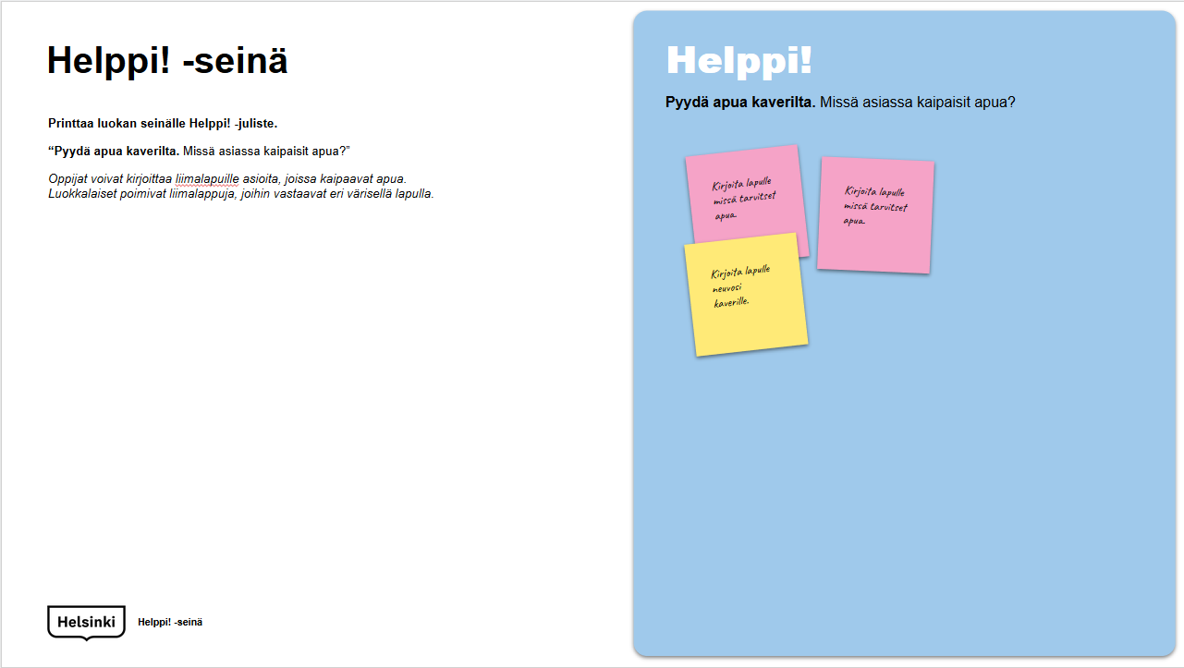
Tools
Ideas for peer review (p. 28)
Cooperation (p. 29)
TOOLS I Subject-specific assessment

Slide 6
Ideas for peer review
Compliment a friend
What did your friend succeed at
especially well?
Development proposals
Describe which skills your friend
could still work on.
Self-reflection
Think about a development proposal received. Did it lead to an improvement?
Did you ignore the proposal?
Why?
Borrow
What new things did you learn from your friend? How do you intend to
utilize it in your own work?
Members of the class/group assess each other’s and their own work, and learn from one another.
An assessment can be made e.g. verbally, by drawing and writing.
BORROWING, SELF-REFLECTION AND PEER REVIEW

Slide 7
Help! Wall
Help!
Ask for help from a friend. What do you need help with?
Print a Help! brochure on the classroom wall.
“Ask for help from a friend. What do you need help with?”
Learners can write things they need help with on sticky notes. Class members select sticky notes to which they respond with a note of a different color.
Write on a note what you need help with.
Write on a note what you need help with.
Write your advice to a friend on a note.
Help! Wall

Slide 8
Thank You!

